Slide 1
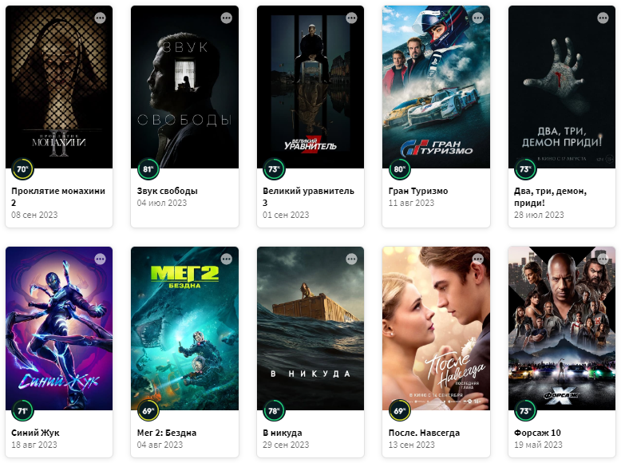

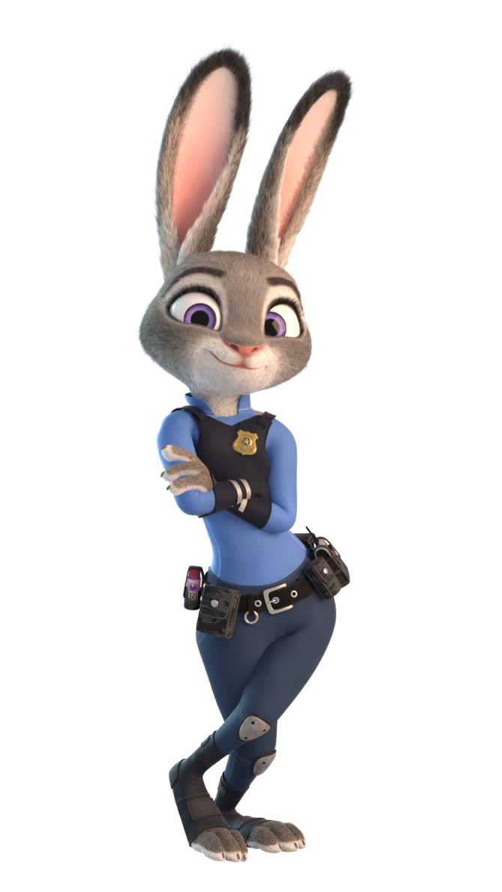
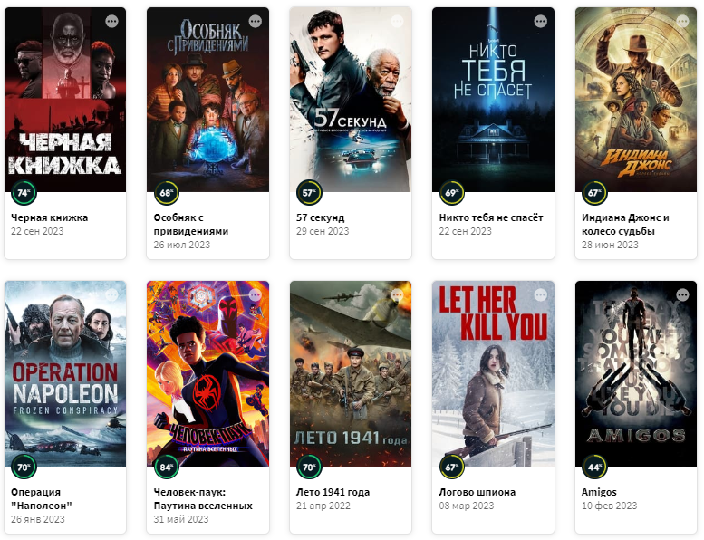
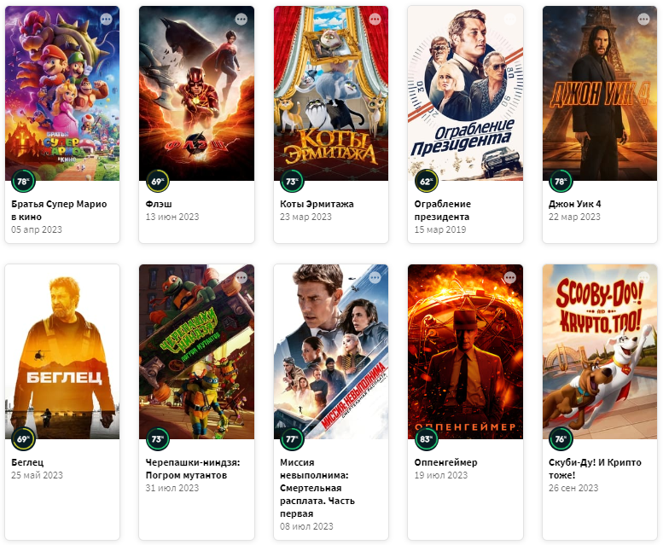

Full TMDB Movies Dataset 2023
Мамедов Ильгар Габилович
Аксенов Антон Витальевич
Васильев Николай Николаевич
Янин Василий Викторович
Маркова Александра

Slide 2
Data description
The TMDb (The Movie Database) is a comprehensive movie database that provides information about movies, including details like titles, ratings, release dates, revenue, genres, and much more.
Contains data for 930,000 movies from TMDb database
The data was collected in October 2023
Variables:
id | revenue | imdb_id | tagline
title | runtime | original_language | genres
vote_average | adult | original_title | production_companies
vote_count | backdrop_path | overview | production_countries
status | budget | popularity | spoken_languages
release_date | homepage | poster_path

Slide 3
Data description
Variable Description Type
‘id’ Unique identifier for each movie given by TMDb int
‘title’ Title of the movie str
‘vote_average’ Average rating of the movie. If 0, no vote_average data was available float
‘vote_count’ Number of votes for the movie. If 0, no vote_count data was available Int
‘status’ Current status of the movie (e.g., "Released", "Post-production", "In Production") str
‘release_date’ Release date of the movie str
‘revenue’ Total revenue generated by the movie in USD. If 0, no revenue data was available int
‘runtime’ Duration of the movie in minutes. If 0, no runtime data was available int
‘adult’ Indicates whether the movie is considered suitable for adults only bool
‘backdrop_path’ URL of the backdrop image for the movie str
‘budget’ Budget allocated for the movie in USD. If 0, no budget data was available float
‘homepage’ URL of the movie's official website, if available str
‘imdb_id’ IMDb identifier for the movie str
‘original_language’ Original language of the movie str
‘original_title’ Original title of the movie str
‘overview’ Brief overview or plot summary of the movie str
‘popularity’ Popularity score of the movie. If 0, no popularity data was available float
‘poster_path’ URL of the poster image for the movie str
‘tagline’ Tagline or slogan associated with the movie str
‘genres’ Genres associated with the movie str
‘production_companies’ Production companies involved in the movie str
‘production_countries’ Countries where the movie was produced str
‘spoken_languages’ Languages spoken in the movie str

Slide 4


Data description - Example
‘title’: The Dark Knight
‘poster_path’:
‘genres’:
Drama
Action
‘production_companies’:
DC Comics,
Legendary Pictures,
Syncopy,
Isobel Griffiths,
Warner Bros. Pictures
‘production_countries’:
United Kingdom,
United States of America
‘spoken_languages’:
English
‘id’: 155
‘vote_average’: 8.512
‘vote_count’: 30,619
‘adult’: FALSE
‘imdb_id’: tt0468569
‘original_language’: en
‘popularity’: 130.643
‘original_title’: The Dark Knight
‘backdrop_path’:
Crime
Thriller
‘tagline’: Welcome to a world without rules.
‘homepage’: https://www.warnerbros.com/movies/dark-knight/
‘overview’:
Batman raises the stakes in his war on crime. With the help of Lt. Jim Gordon and District Attorney Harvey Dent, Batman sets out to dismantle the remaining criminal organizations that plague the streets. The partnership proves to be effective, but they soon find themselves prey to a reign of chaos unleashed by a rising criminal mastermind known to the terrified citizens of Gotham as the Joker.
Mandarin
‘status’: released
‘release_date’: 16/07/2008
‘revenue’: 1,004,558,444
‘runtime’: 152
‘budget’: 185,000,000

Slide 5
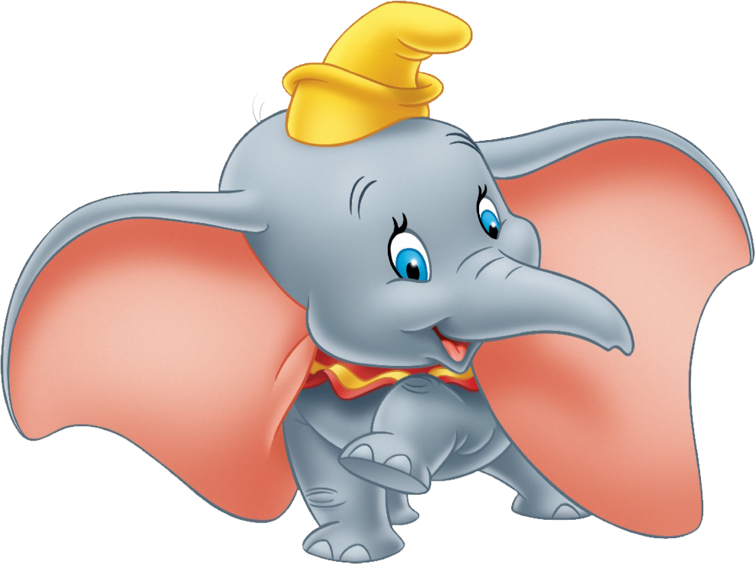
Why is this important?
Key points
Target audience
Industry Efficiency
Save resources
Reduce the number of box office failures
Consumer Satisfaction
Personalized movie recommendations
Economic Impact
Investment optimization
Growth of ticket sales
Boosting streaming service subscriptions
Marketing Effectiveness
Create better-targeted promotions
Investment Decision-Making
Creating more sustainable and profitable film ecosystem
Government and Policy Impact
Targeted support of the film industry
Research and Insights
Movie Studios and Producers
Streaming Services
Marketing
Audience
Investors
Government and Film Industry Regulators
Researchers

Slide 6

1
2
What was done before us
Goal: Rating Prediction
Data preprocessing
Reencoding missing variables
Results:
 | Depth | RSME
CatBoost | 8 | 0.962
Data processing
OneHotEncoding
for categorical variables
‘genres’
‘production_companies’
‘production_countries’
‘spoken languages’
RareLabelEncoding
for categorical variables
'release_decade’
'runtime’
'adult’
'original_language’
Source: https://www.kaggle.com/code/dima806/2023-tmdb-movie-rating-autoviz-catboost-shap

Slide 7
1
2
What was done before us
Goal: Revenue Prediction
Data preprocessing
All gaps have been removed
Only movies with the status 'Released' have been kept
All observations prior to 1891 and after 2030 have been deleted
Two analysis options:
For the entire sample
For the sample with positive revenue only
Results: | R²
Linear model | 0.13
Linear model with positive coefficient constraint | 0.12
Ridge with coefficient tuning | 0.16
ElasticNet with coefficient tuning | 0.16
SGD with tuning | 0.08
Single-layer network with 100 hidden units | 0.47
Selected variables
Revenue
Popularity
Genres
Runtime
Vote_average
Data processing
OneHotEncoding
for categorical variables
StandardScaler
for quantitative variables
Source: https://www.kaggle.com/code/makinpancakes/movies-analysis

Slide 8
Preprocessing
Text Analysis
Models
Dropping the columns:
'backdrop_path’
'homepage’
'imdb_id’
'original_title’
'poster_path’
'tagline’
Vote average:
Converting into integer values
Release date:
Creating new features:
Year
Month
Day
Quarter
Dropping ‘release_date’
Original language:
‘en’ - English
‘fr’ - French
‘es’ - Spanish
‘de’ – German
‘ja’ – Japanese
‘it’ - Italian
‘ot’ – Other
Popularity
Dropping missing values
Genres:
Filling missing values with ‘no genre’
Runtime:
Filling missing data with median runtime
Status:
1 – Released
0 – Otherwise
Revenue:
1 – Has revenue data
2 – Otherwise
Adult:
1 – 18+ movies
0 – Otherwise
Budget:
1 – Has budget data
2 – Otherwise

Slide 9
Preprocessing
Text Analysis
Models
Production companies:
Filling missing values with ‘no pc’
Grouping all unpopular production companies as ‘other_pcs’
Production countries:
Filling missing values with ‘no country’
Grouping all unpopular production countries as ‘other_countries’
Spoken language:
Filling missing values with ‘no language’
Grouping all unpopular spoken language as ‘other_languages’
'legendary pictures' | 'dc comics' | '20th century fox'
'syncopy' | 'isobel griffiths' | 'ingenious media'
'warner bros. pictures' | 'dune entertainment' | 'other_pcs'
'lynda obst productions' | 'lightstorm entertainment'
'united kingdom' | 'australia' | 'hong kong'
'united states of america' | 'south africa' | 'taiwan'
'canada' | 'france' | 'other_countries'
'new zealand' | 'germany'
'english' | 'mandarin' | 'xhosa'
'french' | 'spanish' | 'persian'
'japanese' | 'hindi' | 'other_languages'
'swahili' | 'russian'

Slide 10
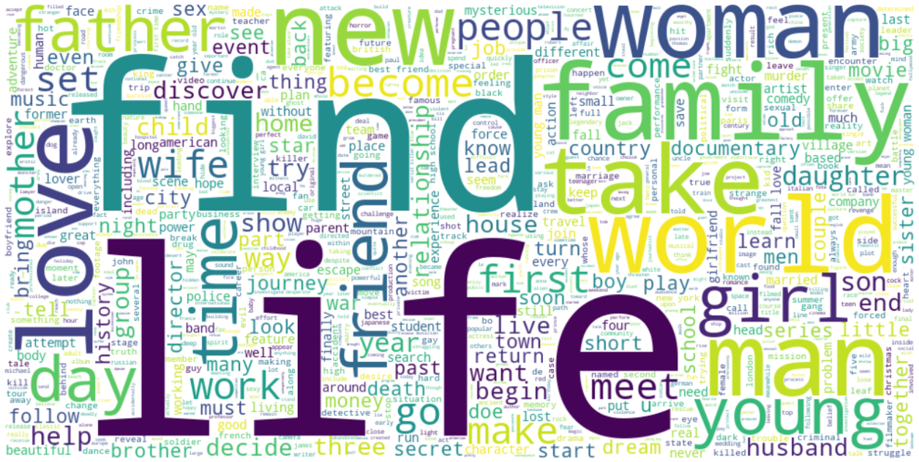
Preprocessing
Text Analysis
Models
Main steps in text analysis
Created a subsample
The formed subsample was excluded from further training
Text preprocessing:
Tokenization
Lemmatization
Stop word removal
Conversion to lowercase
2 methods of topic modeling:
Clustering with K-Means + TF-IDF
Running LDA using Bag-of-words
Both methods were trained on an isolated subsample
Results were applied to the training and testing datasets, creating new features for model training

Slide 11
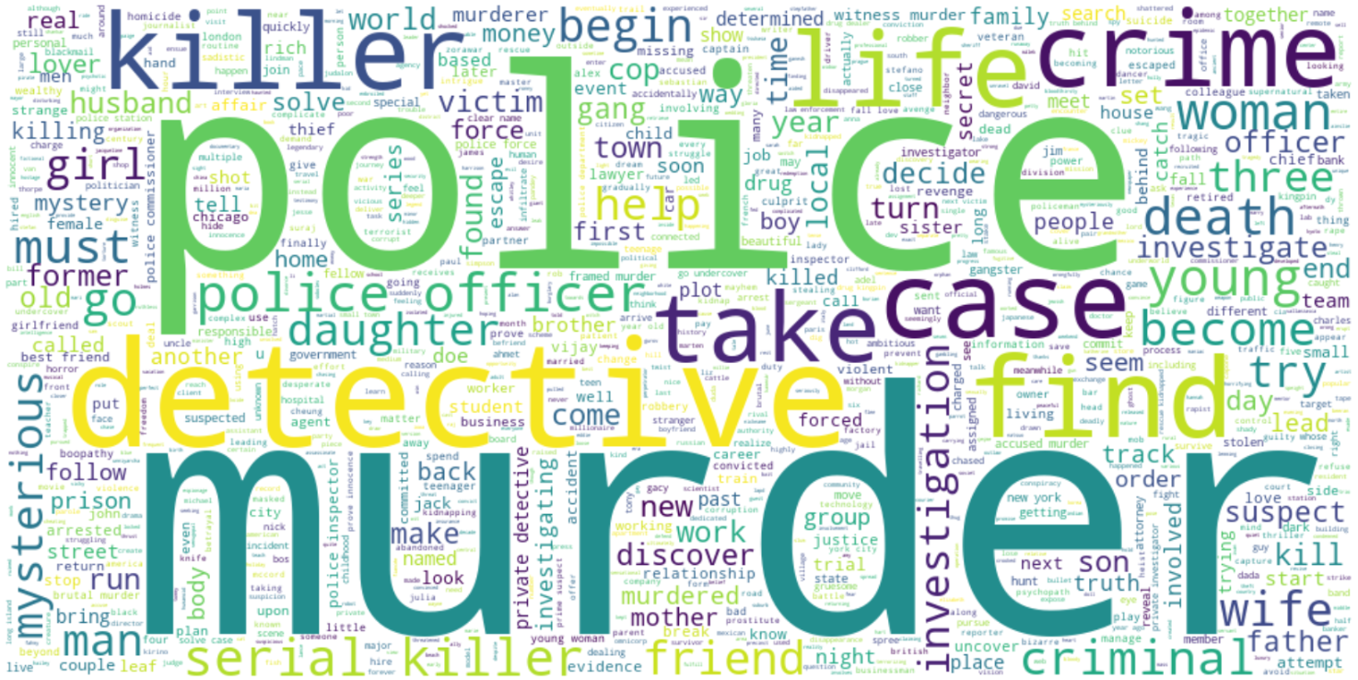
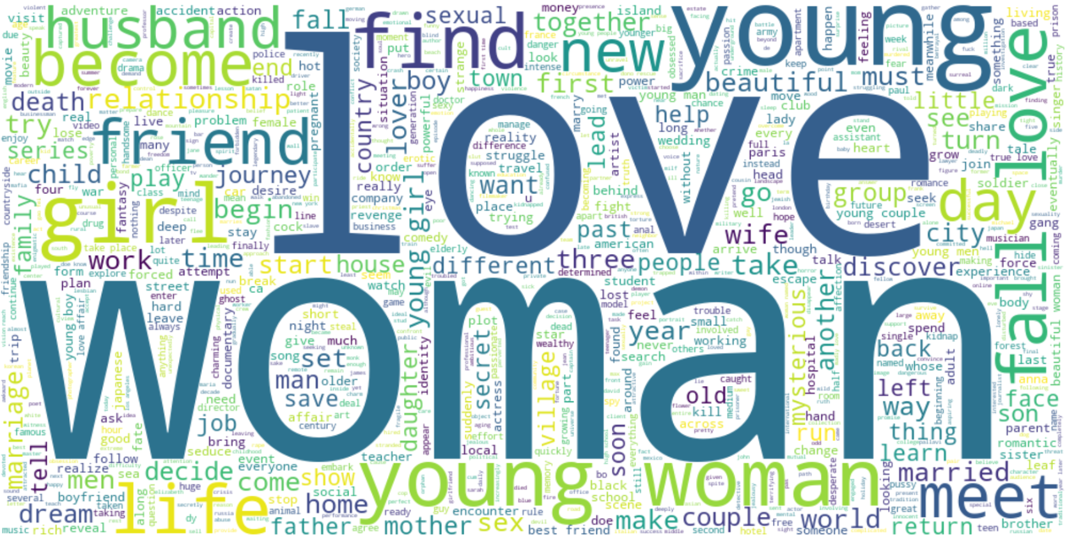
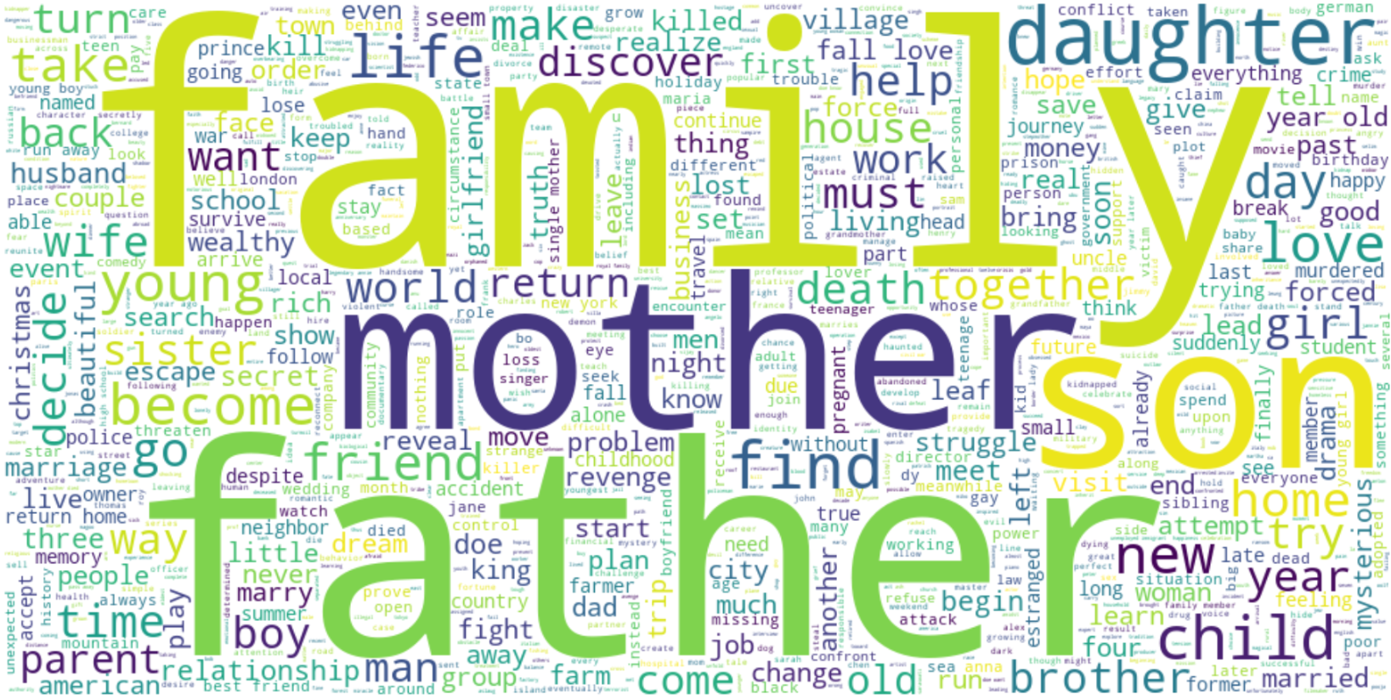
Preprocessing
Text Analysis
Models
Detectives & Thrillers
K-means & TF-IDF
Hyperparameters:
n_clusters = 6
min_df = 0.01
Romantic Movies
Family Movies

Slide 12
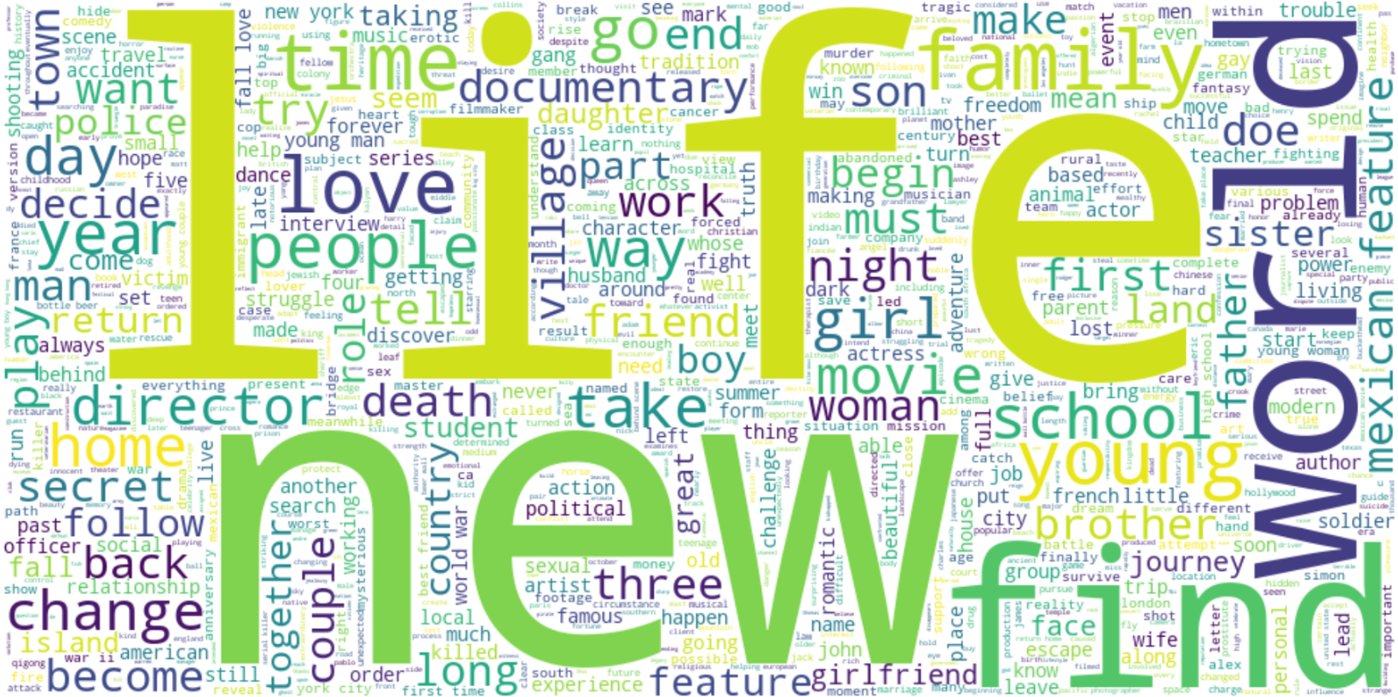
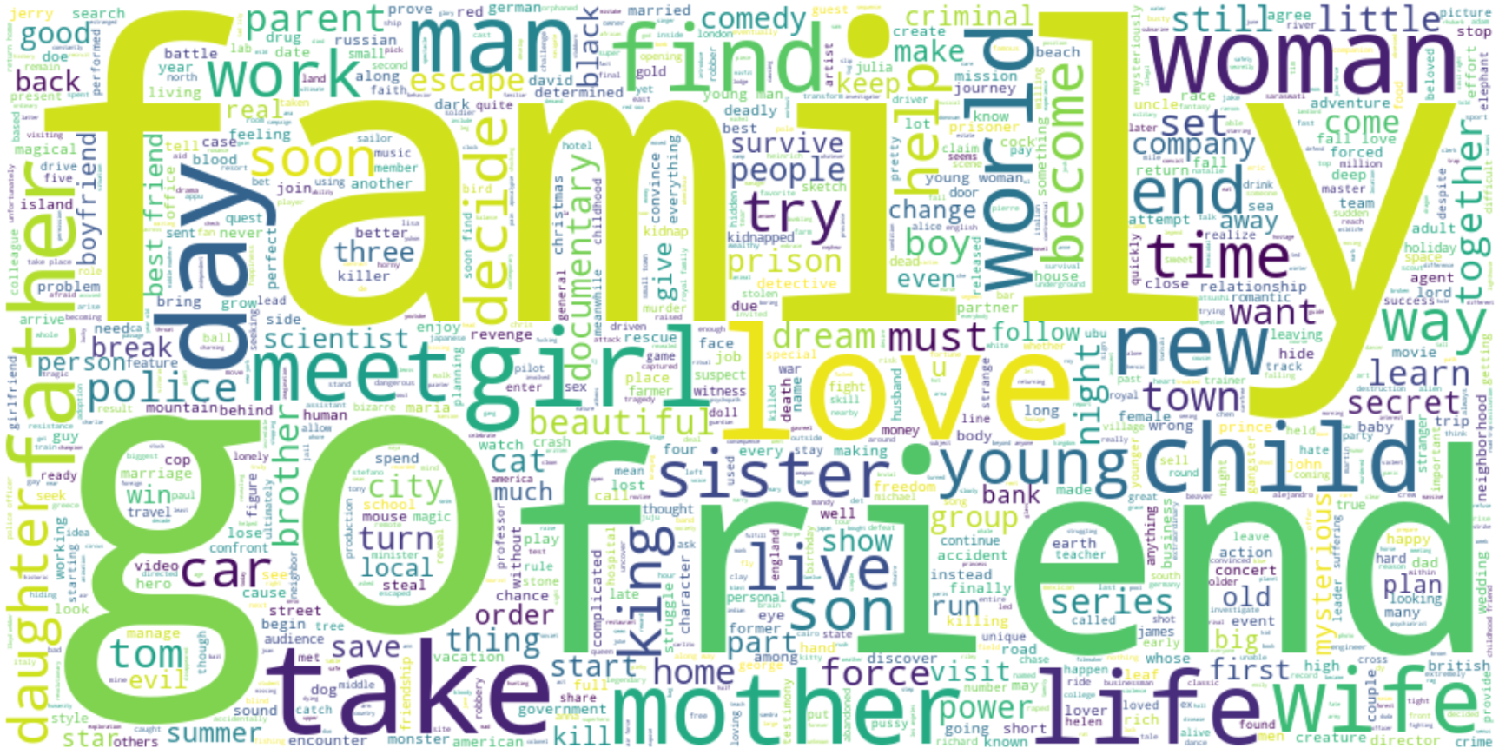

Preprocessing
Text Analysis
Models
Inspirational Movies
LDA (Latent Dirichlet allocation)
LDA builds vector representation of each text - a vector of probabilities of belonging to a certain topic
Hyperparameters:
n_components = 16
Family Movies
Biopic

Slide 13
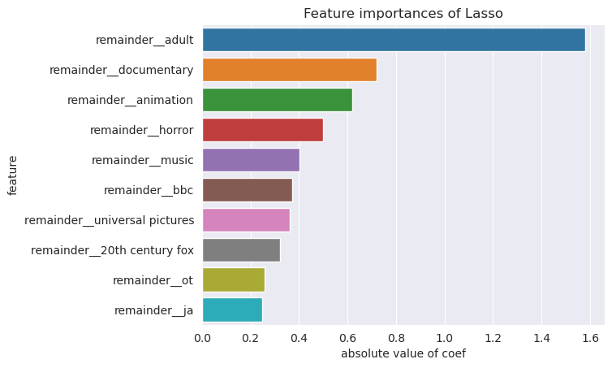
Preprocessing
Text Analysis
Models
Baseline Models
Linear Models
 | RMSE | MAE | R^2
Ridge | 1.15 | 0.88 | 0.15
Lasso | 1.15 | 0.88 | 0.15
ElasticNet | 1.15 | 0.88 | 0.15

Slide 14
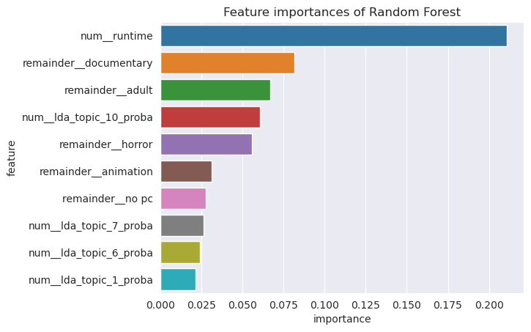
Preprocessing
Text Analysis
Models
Baseline Models
Random Forest
 | RMSE | MAE | R^2
Random Forest | 1.11 | 0.85 | 0.20
Random Forest using PCA | 1.13 | 0.87 | 0.17

Slide 15

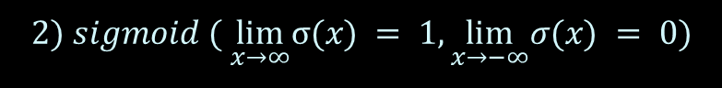
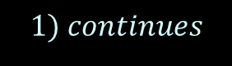
Preprocessing
Text Analysis
Models
Universal approximation thermos (UAT, Cybenko, 1989)
$$Let σ: R →R is an activation function, which is:$$
$$1) continues$$
$$2) sigmoid ( \lim_{x→∞}σ(x) = 1, \lim_{x→−∞}σ(x) = 0)$$
$$We can fix error level ∀ε> 0$$
$$For any continues function f:{\left[0,1\right]}^{d}→R∈ C\left({\left[0,1\right]}^{d}\right)$$
$$there is 2layer FullyConnectedNetwork,which uniforly approximates f:$$
$$g\left(x\right)=A+\sum_{i=1}^{n}{v_{i}σ\left(w_{i}^{T}x+b_{i}\right)}$$
$$sup\left|f\left(x\right)−g\left(x\right)\right|≤ ε$$

Slide 16


Preprocessing
Text Analysis
Models
 | Architecture | Optimizer | Learning Rate | Scheduler | RMSE
Baseline | 2 layers (64 neurons) | Adam | lr = 1e-4 | StepLR(gamma=0.9) | 1.31
Specification 1 | 2 layers (128 neurons) | Adam | lr = 1e-4 | StepLR(gamma=0.9) | 1.29
Specification 2 | 2 layers (128 neurons) | Adam | lr = 1e-4 | CosineAnnealingLR | 1.29
Specification 3 | 2 layers (128 neurons) | AdamW | lr = 1e-4 | CosineAnnealingLR | 1.28
Specification 4 | 2 layers (128 neurons) + (64 neurons) | AdamW | lr = 1e-4 | CosineAnnealingLR | 1.28
Final Specification | 2 layers (128 neurons) + batchnorm + (64 neurons) + batchnorm | AdamW | lr = 1e-3 | CosineAnnealingLR | 1.26

Slide 17
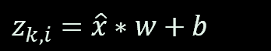
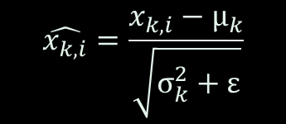
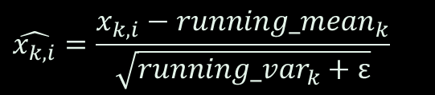
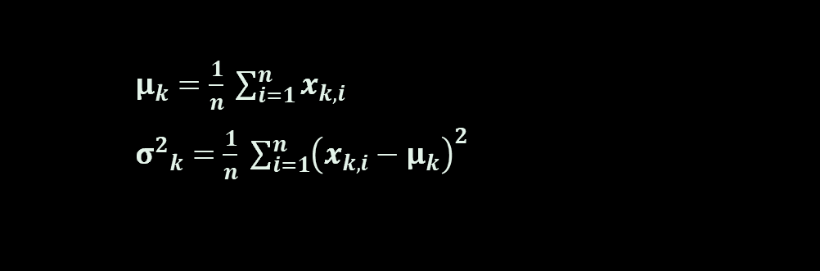
Preprocessing
Text Analysis
Models
BatchNorm
m (momentum) = 0.1
Train
Test
for b=1 to num_batches do
for k=1 to num_features do
$$\hat{x_{k,i}}=\frac{x_{k,i}−running_mean_{k}}{\sqrt{running_var_{k}+ε}}$$
$μ_{k}=\frac{1}{n} \sum_{i=1}^{n}{x_{k,i}}$
${σ^{2}}_{k}=\frac{1}{n} \sum_{i=1}^{n}{{\left(x_{k,i}−μ_{k}\right)}^{2}}$
$z_{k,i}=\hat{x}∗w+b$
$$\hat{x_{k,i}}=\frac{x_{k,i}−μ_{k}}{\sqrt{σ_{k}^{2}+ε}}$$
$$running_mean_{k,t}=\left(1−m\right) running_mean_{k,t−1}+mμ_{k}$$
$$running_var_{k,t}=\left(1−m\right) running_var_{k,t}+mσ_{k}^{2}∗\frac{n}{n−1}$$
$z_{k,i}=\hat{x}∗w+b$
$w$, $b$ – trainable params

Slide 18
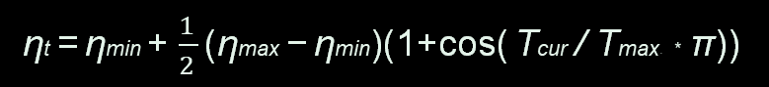
Preprocessing
Text Analysis
Models
AdamW
CosineAnnealingLR
λ (weight decay) = 0.01,
f (loss function),
θ (params),
γ (learning rate)
ηt​ =ηmin ​+ $\frac{1}{2}$​(ηmax​ −ηmin​)(1+cos(Tcur / Tmax​ ​​* * π))
for t =1 to…do
gt ​ ← ∇θ​ ft​ (θt−1​)
θt​ ← θt−1 ​− γλθt−1
​mt​ ← β1​ mt−1​ + (1−β1​)gt
​vt​ ← β2​ vt−1​ + (1−β2​)gt2
​mt​​ ← mt​ / (1−β1^{t})
vt​​ ← vt ​/ (1−β2^{t})
θt​ ← θt​ − γmt​​ / (vt​​​ +ϵ)
return θt​​
learning rate
step

Slide 19
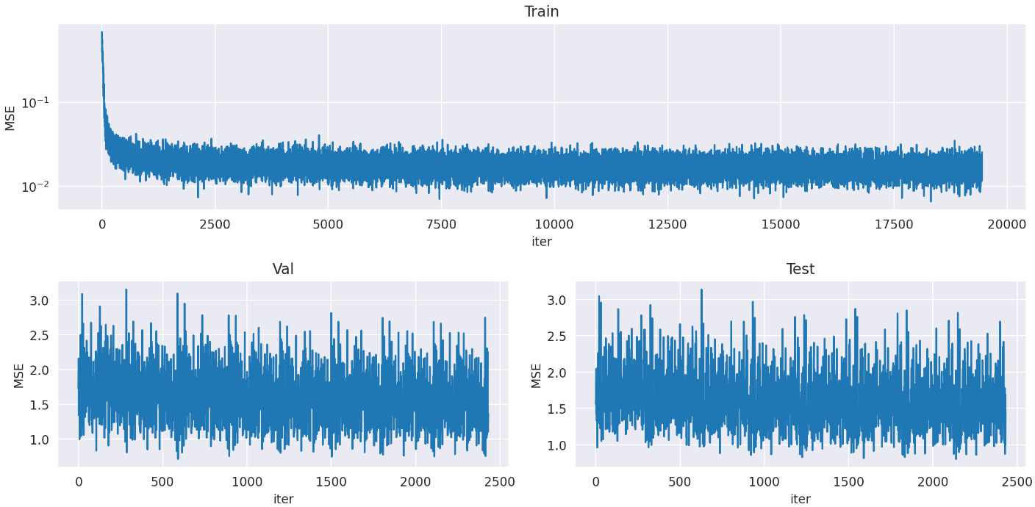
Preprocessing
Text Analysis
Models
Final Model

Slide 20
Preprocessing
Text Analysis
Models
128 n.
64 n.
Final Model
Architecture | 2 layers (128 neurons) + batchnorm + (64 neurons) + batchnorm
Optimizer | AdamW
Learning Rate | 1e-3
Scheduler | CosineAnnealingLR
RMSE | 1.26
R2 | 0.17
MAE | 0.96
X
BatchNorm
BatchNorm

Slide 21
1
2
FYI: shap values
Shap value can show how important specific feature can be in a black box model like Boosting
Algorithm (suppose we want calculate importance of F4):
Step 1 – Shuffle positions of features (F1, F2, F3, F4) -> (F1, F2, F4, F3)
Step 2 – We need to take two objects from our dataset A = (a1, a2, a3, a4), B = (b1, b2, b3, b4)
Step 3 – reshuffle features in objects like in step 1: A = (a1, a2, a4, a3), B = (b1, b2, b4, b3)
Step 4 – . Create new object X1, where all feature on the right side of F4 in object A will be replaced with features of object B. X1 = (a1, a2, a4, b3), X2 = (a1, a2, b4, b3)
Step 5 – Calculate prediction of model for X1 and X2. The difference between predictions of X1 and X2 will be shap value for F4
Step 5+ - repeat previous steps n times and take mean of shaps in step 5. This will be shap value for F4
https://habr.com/ru/companies/wunderfund/articles/739744/

Slide 22
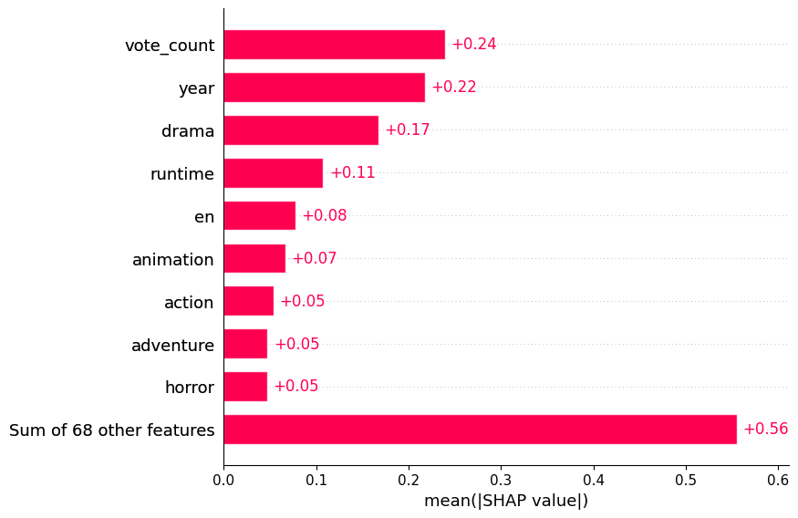
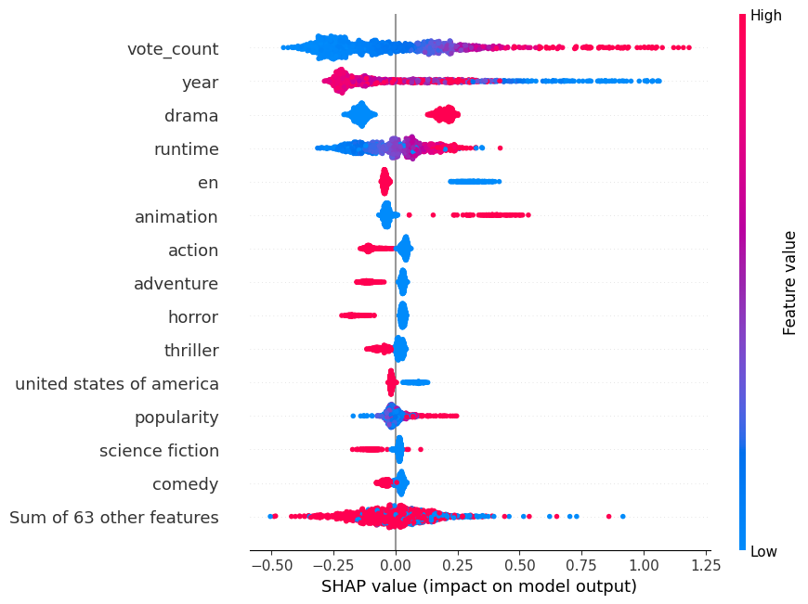
RMSE: 0.51 R2: 0.57
MAE: 0.39
CatBoost V1
Summary:
Non-significant features:
‘original_language’ – Original language of the movie
‘spoken_languages’ – Languages spoken in the movie
‘production_companies’ – Production companies involved in the movie
Most important features:
‘vote_count’ – number of votes for the movie
‘year’ – year when the film was released
‘runtime’ – duration of the movie in minutes

Slide 23
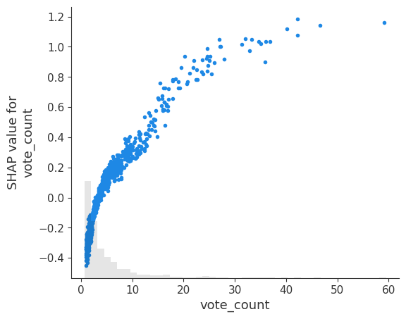
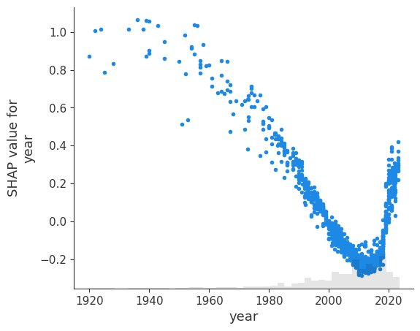
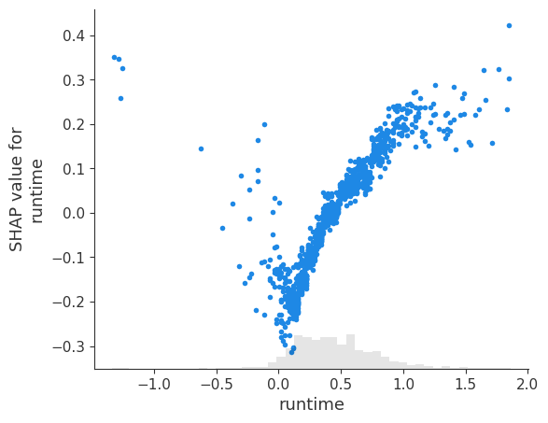
RMSE: 0.51 R2: 0.57
MAE: 0.39
CatBoost V1
Summary:

Slide 24
RMSE: 0.51 R2: 0.57
MAE: 0.39
CatBoost V2
Summary:
Non-significant features:
‘original_language’ – Original language of the movie
‘spoken_languages’ – Languages spoken in the movie
Most important features:
‘vote_count’ – number of votes for the movie
‘year’ – year when the film was released
‘runtime’ – duration of the movie in minutes
Genre – name of the genre in TMDB

Slide 25
CatBoost V2
Summary:
RMSE: 1.67

Slide 26

Thank you for attention!

